Slide 1

SECD2523 DATABASE
SQL 5b | TCL

Slide 2
LECTURE LEARNING OUTCOME
By the end of this lecture, students should be able to:
Construct SQL statements for Discretionary Access Control:
01
Granting Privileges to Other Users (GRANT)
02
Revoking Privileges from Users (REVOKE)

Slide 3
01
Granting Privileges to Other Users (GRANT)
02
Revoking Privileges from Users (REVOKE)

Slide 4
Before we continue this TCL, we reuse the same database same tables created in DML3 mysql: use db_dml3_dept_emp_loc;
If failed to find the database and tables you created previously,
refer here to get our SQL statements to prepare all tables and sample data…
https://docs.google.com/document/d/1jC5daHE4WhP7N9U6ZxqRzBJcJAzqJxf1/edit?usp=sharing&ouid=112935562328060013817&rtpof=true&sd=true
Notes:
mysql -u root –p
admin123
show databases;
use db_dml3_dept_emp_loc;

Slide 5
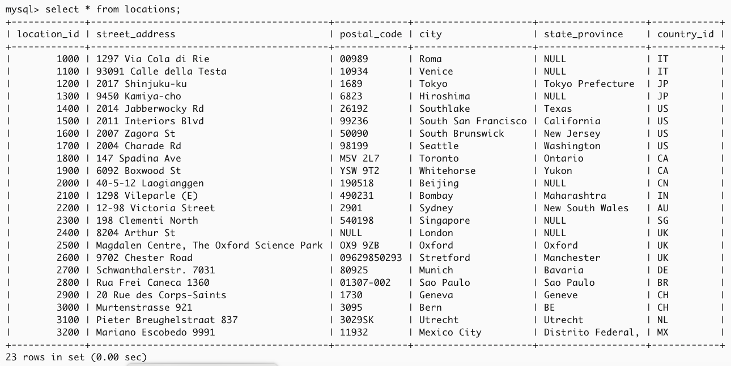
Here, our tables with records
select * from locations;

Slide 6
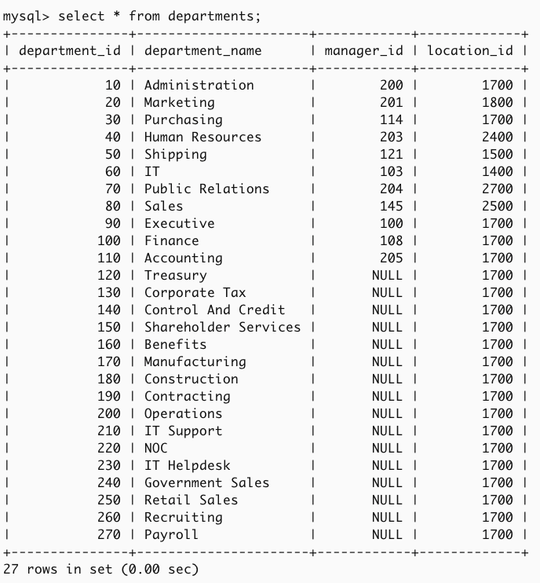
Here, our tables with records
select * from departments;

Slide 7
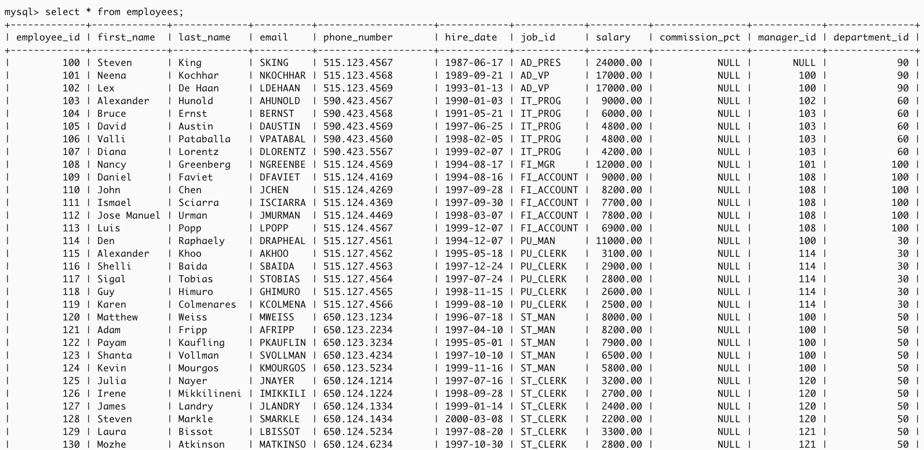

Here, our tables with records
select * from employees;

Slide 8
Let’s start…

Slide 9
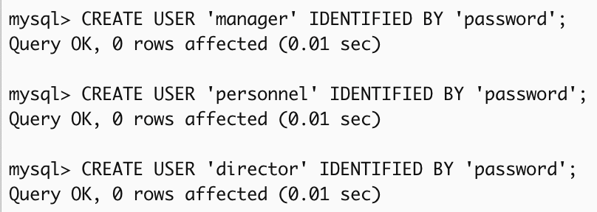
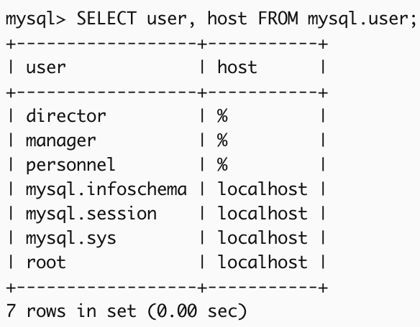
but, create the users first for manager, personnel, and director, use the following mysql query first: display the user list:
CREATE USER 'manager' IDENTIFIED BY 'password';
CREATE USER 'personnel' IDENTIFIED BY 'password';
CREATE USER 'director' IDENTIFIED BY 'password';
SELECT user, host FROM mysql.user;

Slide 10
Discretionary Access Control

Slide 11
Discretionary Access Control
Each user is assigned specific permissions (called privileges) to access or use certain parts of a database.
  Privileges defined by the ISO standard are:
  SELECT—the privilege to retrieve data from a table;
  INSERT [(columnName)]—the privilege to insert new rows into a table;
  UPDATE [(columnName)]—the privilege to modify rows of data in a table;
  DELETE—the privilege to delete rows of data from a table;
  REFERENCES [(columnName)]—the privilege to reference columns of a named table in integrity constraints (related to foreign keys);
  USAGE—the privilege to use domains, collations, character sets, and translations.
Reference: https://dev.mysql.com/doc/refman/8.0/en/privileges-provided.html

Slide 12
Discretionary Access Control
When a user creates something in the database, like a table, they automatically get permissions for it and can share it with others.
  Example:
  When User A creates a table, they automatically have full permission to manage and use it.
  Since User A created the table, they automatically receive permissions like SELECT, INSERT, UPDATE, DELETE, and more.
  User A can share these permissions with User B by granting them specific access rights.
  This gives User B permission to view the data in the table but not to modify it.
  Now, User B can run queries to access the data.

Slide 13
Discretionary Access Control
The system lets users share permissions, but this flexibility can be exploited by someone who tricks a user into sharing confidential information.
  Example:
  Sensitive data exists in the table, like private salary details.
  An unauthorized User C (someone who isn’t supposed to access certain data) asks an authorized User B (someone with legitimate access) for "help" with a database task.
  User C says, "Can you run this query and share the results with me? I can’t access the data myself."
  User B, trusting User C, runs the query and then shares the output, unknowingly revealing sensitive salary data to User C.
SQL supports only discretionary access control through the GRANT and REVOKE statements.
The mechanism is based on the concepts of authorization identifiers, ownership, and privileges

Slide 14
Granting Privileges to Other Users (GRANT)

Slide 15
Granting Privileges to Other Users (GRANT)
GRANT [PrivilegeList | ALL PRIVILEGES]
ON ObjectName
TO [AuthorizationIdList | PUBLIC]
[WITH GRANT OPTION];
Grant All: Use ALL PRIVILEGES to give a user all permissions without listing them individually.
Access for All: Use PUBLIC to allow everyone, now and in the future, to access an object.
Object Types: Permissions can be given for tables, views, or other database objects.
Sharing Privileges: WITH GRANT OPTION lets users pass their permissions to others.
Restrict Sharing: Without WITH GRANT OPTION, users can’t share their permissions.
Note: MySQL doesn’t support PUBLIC.
But can still grant privileges to specific users (using % for any host).

Slide 16
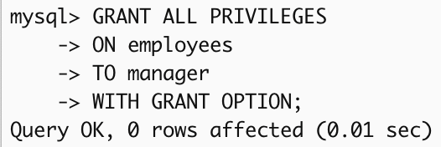
GRANT all privileges
Example 1:
  Give the user with authorization identifier manager all privileges on employees table.
GRANT ALL PRIVILEGES
ON employees
TO manager
WITH GRANT OPTION;
The user manager can now:
view, insert, update, and delete data in employees table.
use employees table and all employees columns in any table that he or she creates.
because WITH GRANT OPTION, manager can share these privileges with other users.

Slide 17
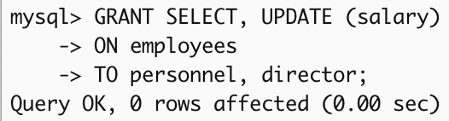
GRANT specific privileges
Example 2:
  Give users personnel and director the privileges SELECT and UPDATE on column salary of the employees table.
GRANT SELECT, UPDATE (salary)
ON employees
TO personnel, director;
The keyword omitted WITH GRANT OPTION, so that users personnel and director cannot share these privileges with other users.

Slide 18
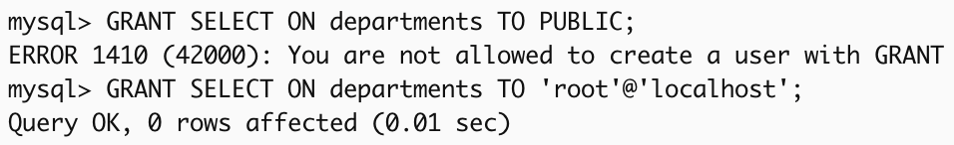



GRANT specific privileges to PUBLIC
Example 3:
  Give all users the privilege SELECT on departments table.
GRANT SELECT
ON departments
TO PUBLIC;
Using the keyword PUBLIC means that all users (now and in the future) can view all the data in departments table.
There is no need to use WITH GRANT OPTION because every user has access to the table.
Note:
MySQL doesn’t support PUBLIC.
But can still grant privileges to specific users (using % for any host).
GRANT SELECT
ON departments
TO 'root'@'localhost';

Slide 19
Revoking Privileges from Users (REVOKE)

Slide 20
Revoking Privileges from Users (REVOKE)
REVOKE [GRANT OPTION FOR] {PrivilegeList | ALL PRIVILEGES}
ON ObjectName
FROM [AuthorizationIdList | PUBLIC]
[RESTRICT | CASCADE];
ALL PRIVILEGES refers to all the permissions (like SELECT, INSERT, DELETE, etc.) a user has been given.
The optional GRANT OPTION FOR clause lets you revoke the privileges sharing (given through WITH GRANT OPTION), without affecting the user's access to the table.
If REVOKE a privilege and it causes an object (like a view) to no longer be needed, the command will fail unless you use the CASCADE keyword. If CASCADE is used, MySQL will automatically delete any unnecessary objects, like views or constraints, that are left behind after revoking the privilege.

Slide 21
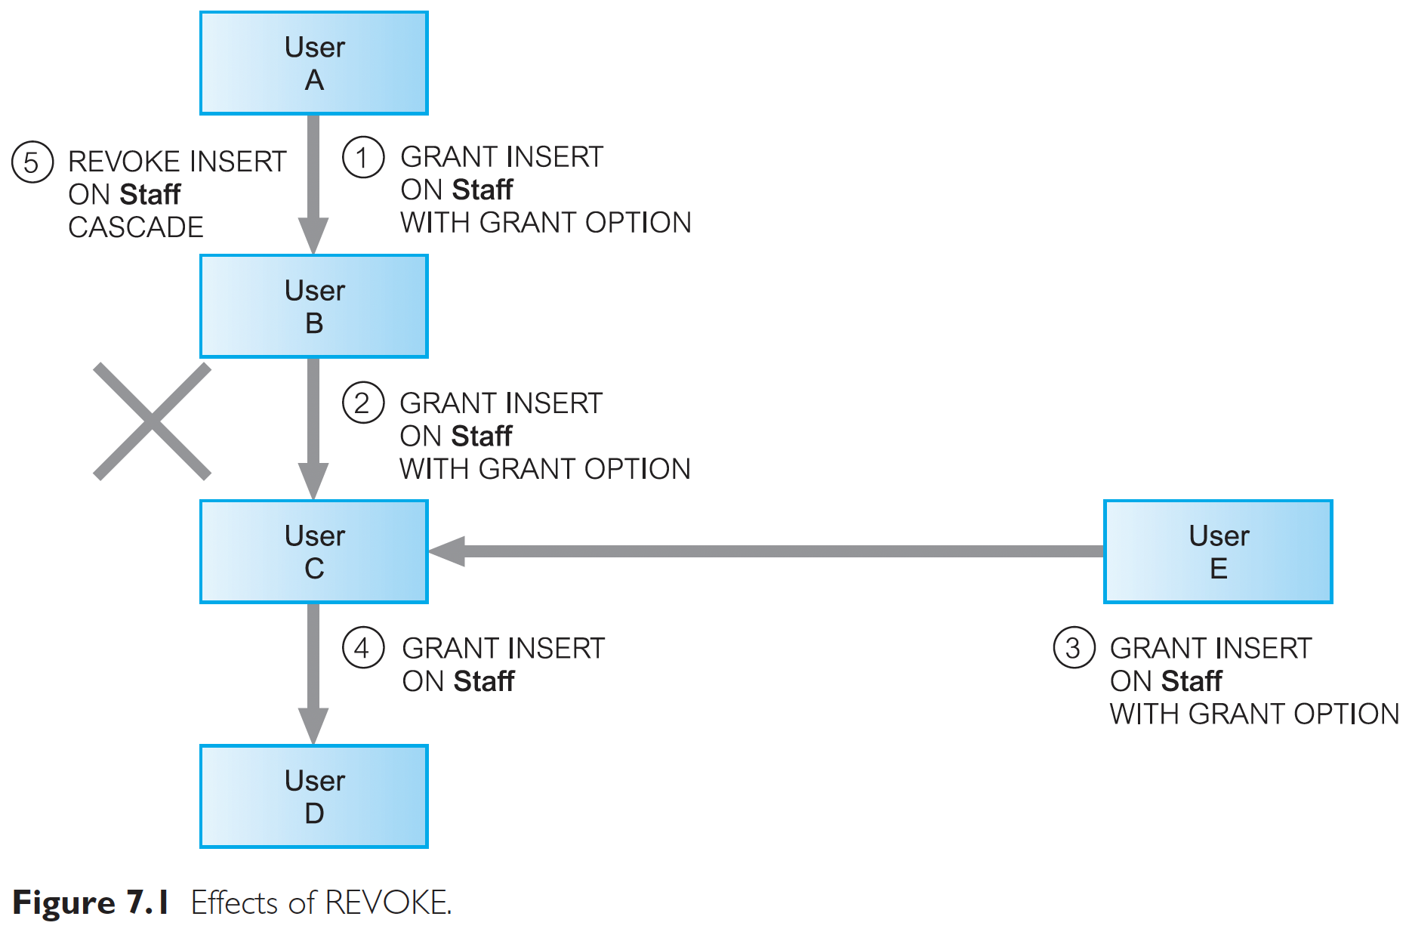
Effects of REVOKE
User A grants User B INSERT privilege on the Staff table WITH GRANT OPTION (step 1).
User B passes this privilege on to User C (step 2).
User C gets the same privilege from User E (step 3).
User C then passes the privilege on to User D (step 4).
When User A removes the INSERT privilege from User B (step 5), it doesn’t affect User C because User C got the privilege from User E.
If User E hadn’t given User C the privilege, the removal would have also applied to User C and User D.

Slide 22
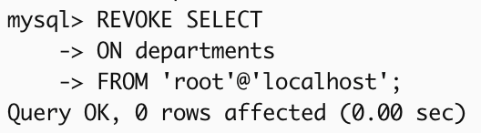



REVOKE specific privileges from PUBLIC
Example 4:
  Revoke the privilege SELECT on departments table from all users.
REVOKE SELECT
ON departments
FROM PUBLIC;
Note:
MySQL doesn’t support PUBLIC.
But can still grant privileges to specific users (using % for any host).
REVOKE SELECT
ON departments
FROM 'root'@'localhost';

Slide 23
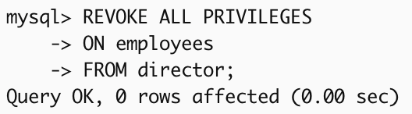
REVOKE specific privileges from named user
Example 5:
  Revoke all privileges you have given to director on the employees table.
REVOKE ALL PRIVILEGES
ON employees
FROM director;

Slide 24
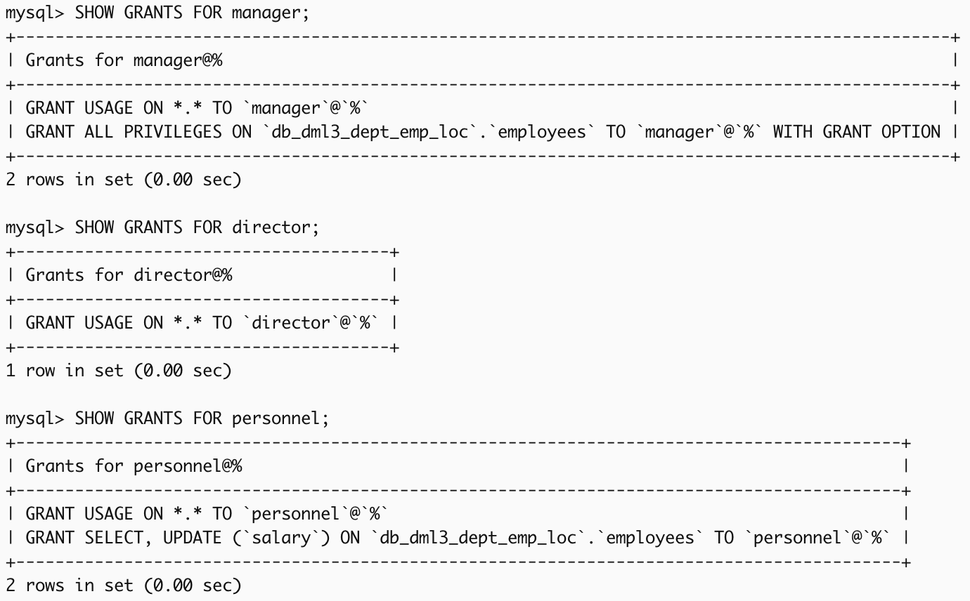
Checking privileges:
SHOW GRANTS FOR manager;
SHOW GRANTS FOR director;
SHOW GRANTS FOR personnel;

Slide 25


